Slide 1
04633-A Embedded systems development Lecture 1: Overview
Emmanuel Ndashimye

Slide 2
Emmanuel Ndashimye
PhD & HEA, AUT, 2018 (NZ) Masters, HUST,2009 (China) B.Tech, UR CST,2005 (Rwanda)
Research: Telecom (Vehicular Network), Security Systems and IoT. Research link: https://scholar.google.com/citations?user=6y_k3EgAAAAJ&hl=en

Slide 3
Course objectives
At the end of this class, student should be able to:
Interface a microcontroller to a variety of analog and digital input and output devices.
Write (C and assembly language) code for a microcontroller
Program a microcontroller to implement a closed loop automatic control.
Wireless communication in embedded systems
Analyze a real-world problem and develop an ES –based project for addressing the problem.

Slide 4
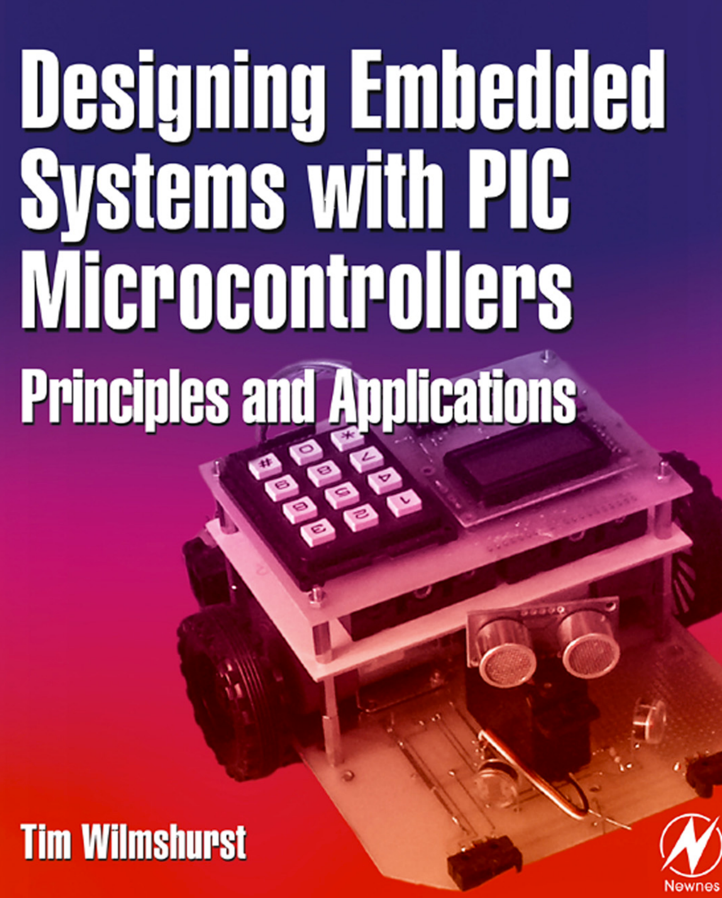
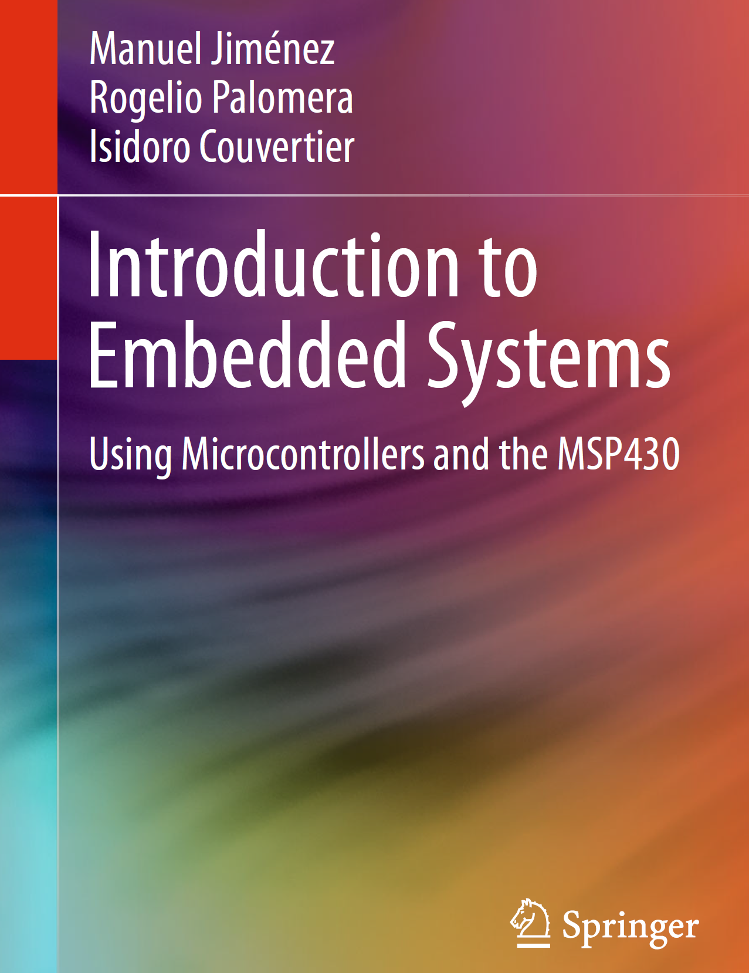
Required Acquisitions
Text book
PIC microcontroller
MPLAB IDE & MPLAB Compiler & Simulator
Arduino
Sensors
Actuators (Motors)
STM32

Slide 5
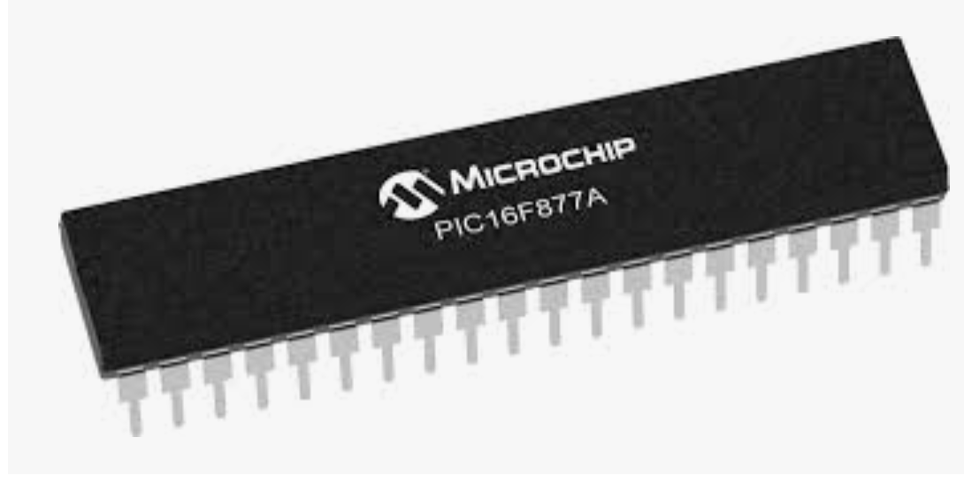


Required Acquisitions
Text book
PIC microcontroller
MPLAB IDE & MPLSB Compiler & Simulator
Arduino
Sensors
Actuators (Motors)
ESP32/ESP8266

Slide 6
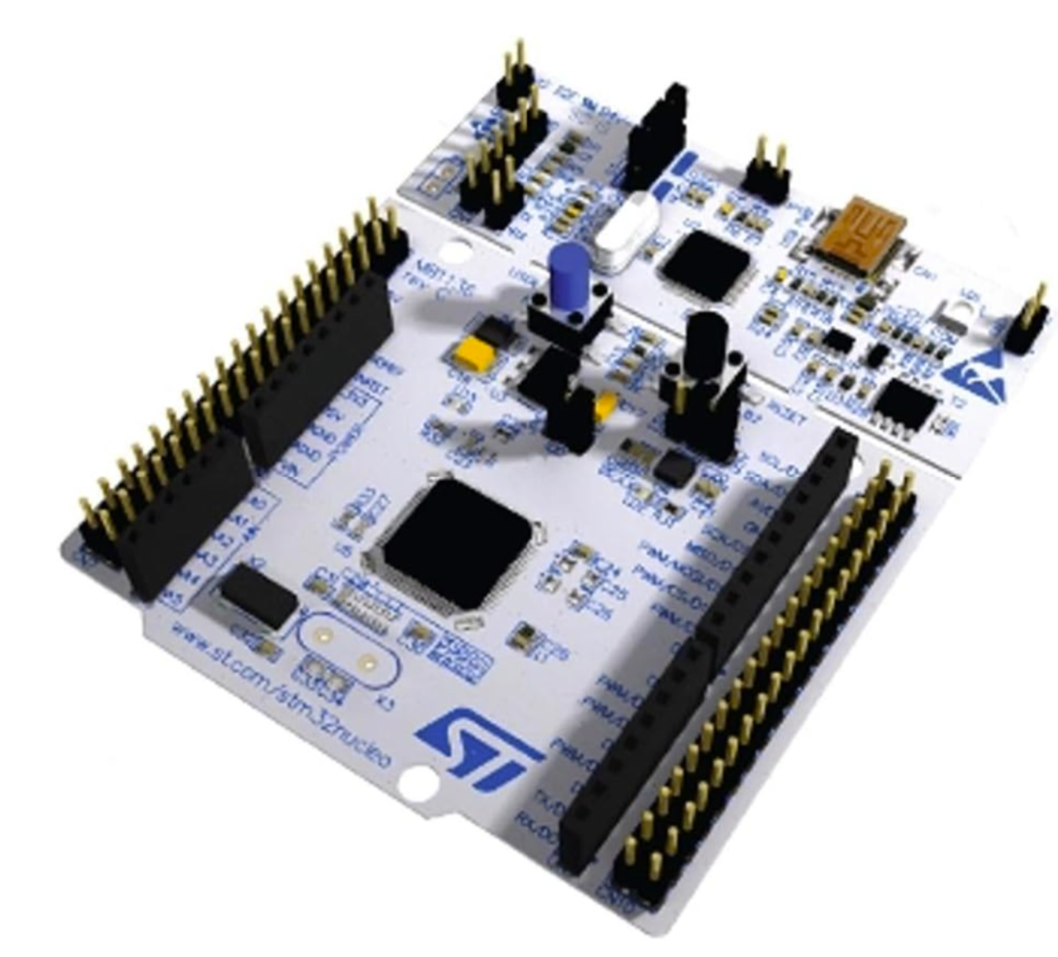
Required Acquisitions
Text book
PIC microcontroller
MPLAB IDE & MPLSB Compiler & Simulator
STM32
Sensors
Actuators (Motors)

Slide 7
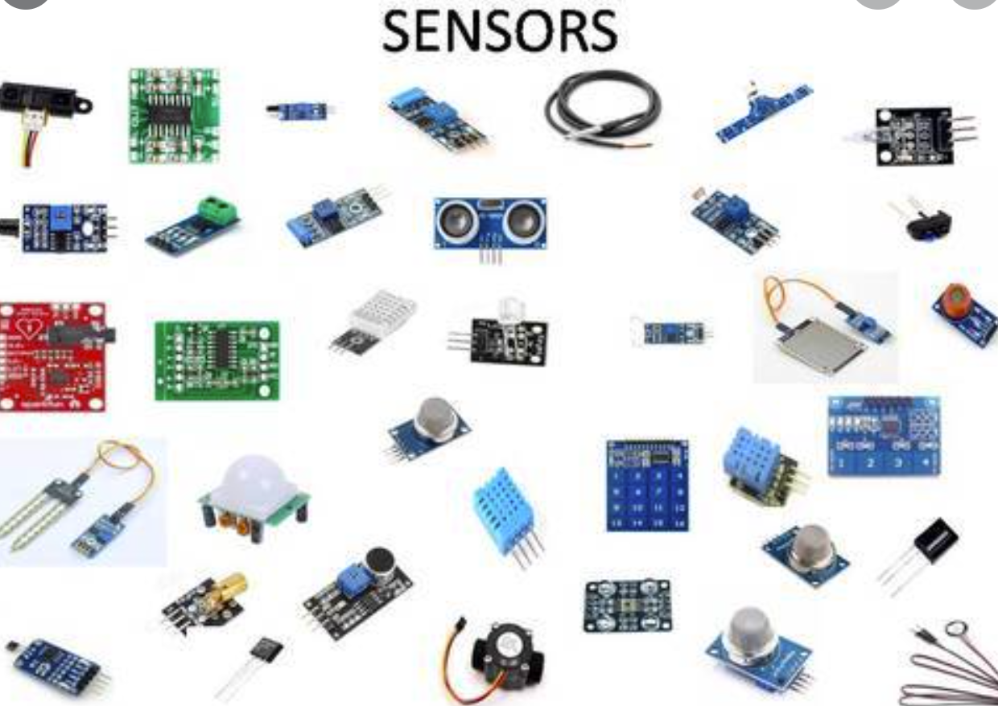
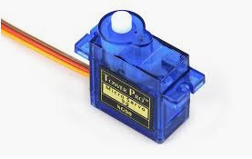
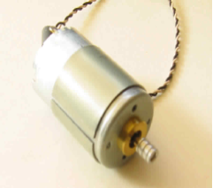
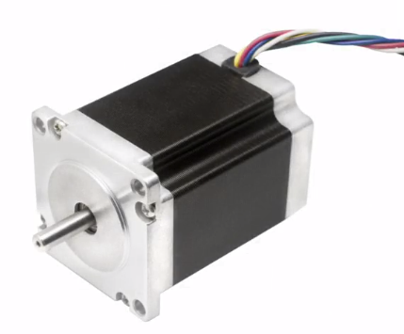
Required Acquisitions
Text book
PIC microcontroller
MPLAB IDE & MPLSB Compiler & Simulator
Arduino & Arduino IDE
Sensors
Actuators (Motors)
STM32

Slide 8
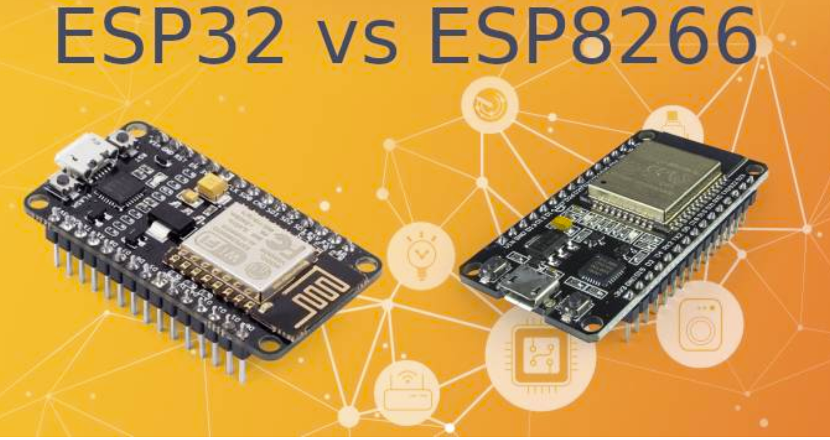
Required Acquisitions
Text book
PIC microcontroller
MPLAB IDE & MPLSB Compiler & Simulator
Arduino
Sensors
Actuators (Motors)
ESP32/ESP8266

Slide 9
Grading
Homework (6 LABs): 50%
Midterm exam (1): 15%
Final Project: 30%
Class participation, quizzes, reading critiques: 5%

Slide 10
Embedded systems Overview

Slide 11
What is an Embedded System?
The basic idea of an embedded system is a simple one. If we take any engineering product that needs control, and if a computer is incorporated within that product to undertake the control, then we have an embedded system.
A system whose principal function is not computational, but which is controlled by a computer embedded within it

Slide 12
What is an Embedded System?
The integration of:
Sensors
Actuators
Intelligence
With a system to produce:
More capable, versatile, and robust performance

Slide 13
Intro to ES
An embedded system is a system whose principal function is not computational, but which is controlled by a computer embedded within it.
An embedded system is some combination of HW and SW, either fixed in capability or programmable, that is specifically designed for a particular function.
A general computer is defined not to be an embedded system
Limited Recourses: ES often must cost just a few dollars, must be sized to fit on single chip, must perform fast enough to process data in real-time, and must consume minimum power to extend battery life.

Slide 14
The Embedded System - What Disciplines does it Involve?
Digital
Integrated Circuit
Electronics
Design
Analogue
Electronics
Computer Architecture
Embedded Systems
Sensors and
Software Engineering
Measurements
Data
Electric Motors &
Communications
Actuators
Control
Engineering

Slide 15
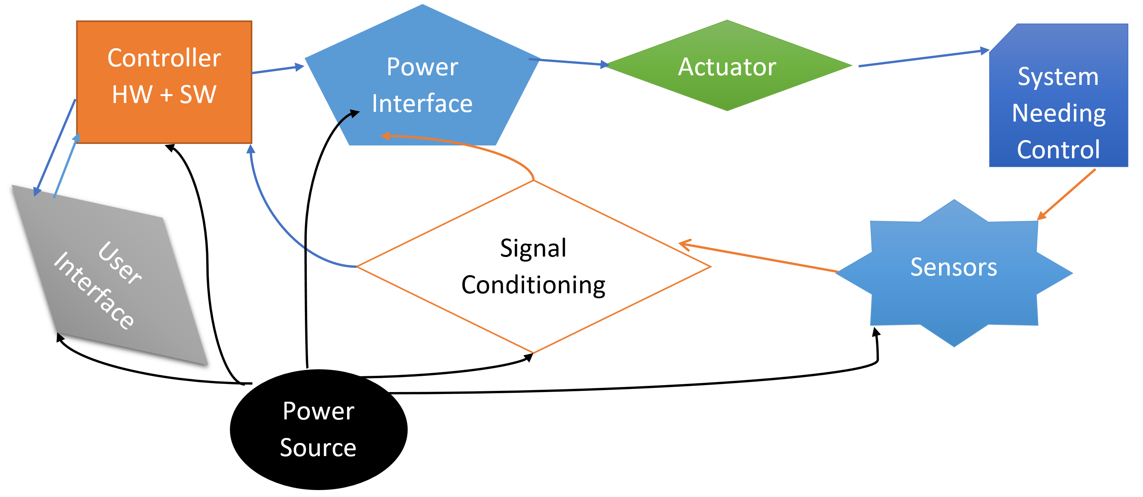
Embedded Systems Concept Map

Slide 16
Connect via peripherals
Embedded systems talk with outside word via peripherals:
Serial communication interfaces(SCI): RS-232,RS-422, RS-485,…
USB
Multi Media Cards: SD Cards, Compact Flash,..
Networks
ADC/DAC
Communication protocols (I2C, Serial UART, SPI)

Slide 17
Embedded Vs PC
Embedded
PC
Defined process and function
Application specific
Numerous ES make up the computer
Tightly constrained(Cost, Size , Performance, and Power)
Generic
Manufactured with general requirement
Enough space for numerous chips and other components
No power challenge

Slide 18
Difference between Embedded and PC app-Coding
Embedded
PC Application
Closer to the Hardware
Use native data types
Fewer system resources
No OS
More efficient algorithms
Higher frequency=higher power
Abstracted HW
Plenty of Resources
Has OS

Slide 19
Example of embedded Systems
Embedded Software is in every electronic device used in real life including cell phone, digital camera, calculators, oven, washing machine, fridge, etc.

Slide 20
Administrivia
Course Website
Check it often
All lectures and lab handouts will be posted on Canvas
You can see your grades here
Piazza for all discussions and announcements:
We love questions, but DO NOT post code in public questions!
TAs
Students with both course and hands-on experience in embedded systems
Office hours: Faculty and TA
Lectures (80min)
Tuesday / Thursday, 12:30 – 1:50PM, HH B103
Textbooks – None required, a few suggestions in Syllabus

Slide 21

Policies on Collaboration
What is okay?
On team labs, definitely work together
Sharing your findings with others, especially over a tricky detail like a register setting…
Clarifying questions posted by other students on Piazza (no solutions or code)

Slide 22
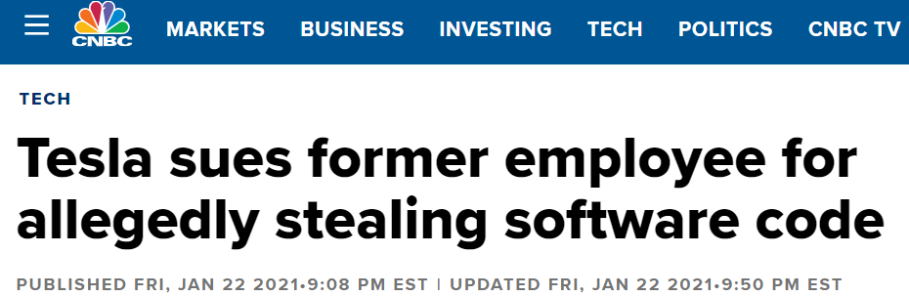
Cheating and Plagiarism
Your code may be compared against others!
CMU cheating policies
Please read and understand: http://www.cmu.edu/policies/documents/Cheating.html
Cheating penalty
Immediate “R” grade and department notification
Copyright warning
Please do not post or otherwise redistribute material from the class
No video or audio recording

Slide 23
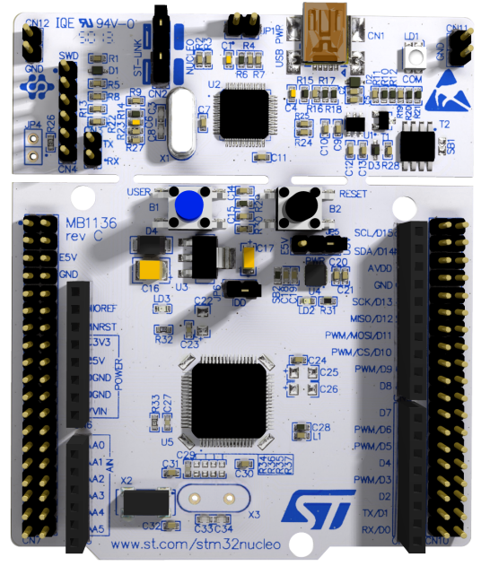
Nucleo-64 Micro-Controller Board
Nucleo-64 MCU Board
ARM Cortex M4 Core
84 MHz
512KB Flash + 96KB SRAM
Arduino Uno v3 and STM32 Connectivity
23

Slide 24
What is an embedded system?

Slide 25

What is an embedded system?

Slide 26
An introduction
Computer system hidden (embedded) in other systems
Often interacts with the physical environment
Purpose built
End users see “smart” device rather then computer
Often the main purpose of using it is not information processing
Special-purpose vs. general-purpose computing

Slide 27
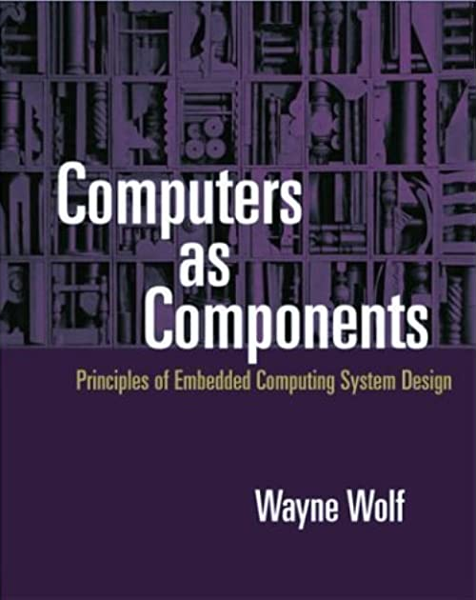
What Is an Embedded System?
“It is any device that includes a programmable computer but is not itself intended to be a general purpose computer.”
– Wayne Wolf

Slide 28

“It is any device that includes a programmable computer but is not itself intended to be a general purpose computer.”

Slide 29

“It is any device that includes a programmable computer but is not itself intended to be a general purpose computer.”

Slide 30

“It is any device that includes a programmable computer but is not itself intended to be a general purpose computer.”

Slide 31
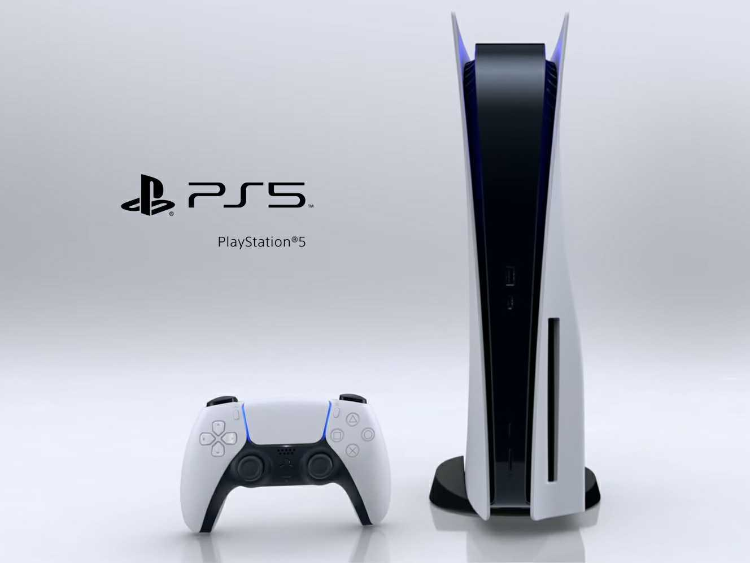
“It is any device that includes a programmable computer but is not itself intended to be a general purpose computer.”

Slide 32
Car Engine Control Unit (ECU)
Functions
Fuel injection
Air intake setting
Spark timing
Exhaust gas circulation
Electronic throttle control
Constraints
Reliability in harsh environment
Cost
Weight
Many Inputs and Outputs
Discrete sensors & actuators
Network interface to rest of car

Slide 33
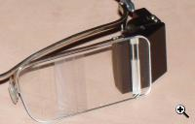
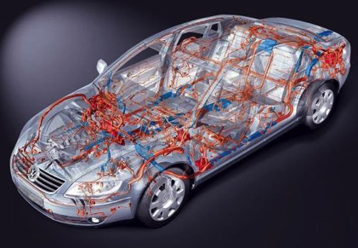
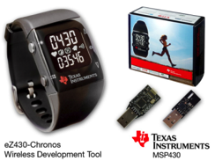
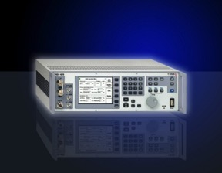
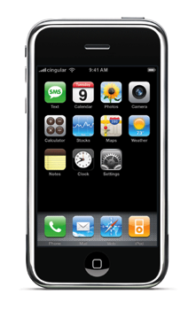
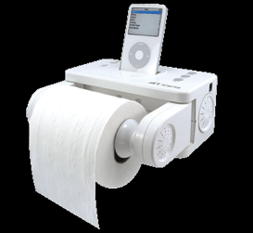
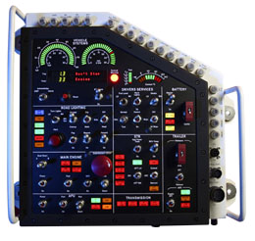
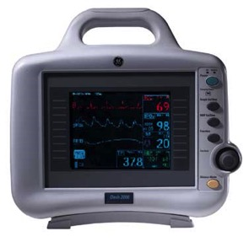
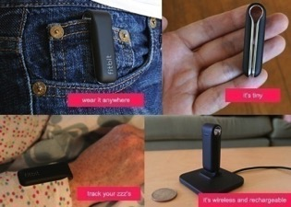
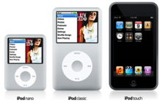
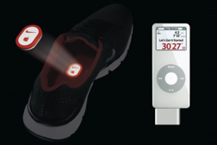
Embedded, Everywhere

Slide 34
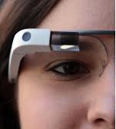

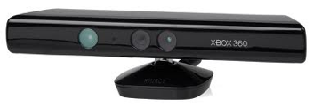
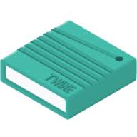
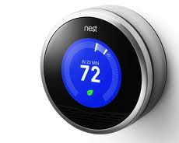
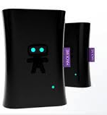


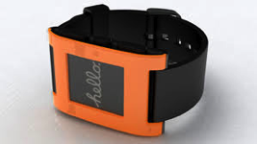
Embedded, Everywhere – Internet of Things
People Connecting
Through Machines
Machines Connecting to Machines
and the Physical Environment

Slide 35
Embedded in Your Daily Life
How many microcontrollers are around you?
Bathroom scale with digital read out
Iron that turns itself off automatically
Electronic toothbrush (with ~3000 lines of code)
Cooking range
Laundry machine and dryer
Toaster
Microwave
Home-security
TV, cable-box, AV system
Game console
Thermostat
Cars, Toys, Medical Devices…
Embedded Systems
Notes:
Furby has a more powerful CPU then original mars lander

Slide 36
Embedded in Your Daily Life
How many microcontrollers are around you?
Bathroom scale with digital read out
Iron that turns itself off automatically
Electronic toothbrush (with ~3000 lines of code)
Cooking range
Laundry machine and dryer
Toaster
Microwave
Home-security
TV, cable-box, AV system
Game console
Thermostat
Cars, Toys, Medical Devices…
Embedded Systems

Slide 37
What is driving the embedded explosion?

Slide 38
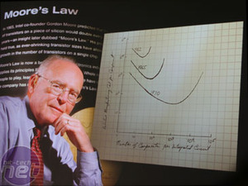
Moore’s Law (a statement about economics): IC transistor count doubles every 18-24 month
Photo Credit: Intel

Slide 39
Flash memory scaling: Rise of density & volumes; Fall (and rise) of prices

Slide 40
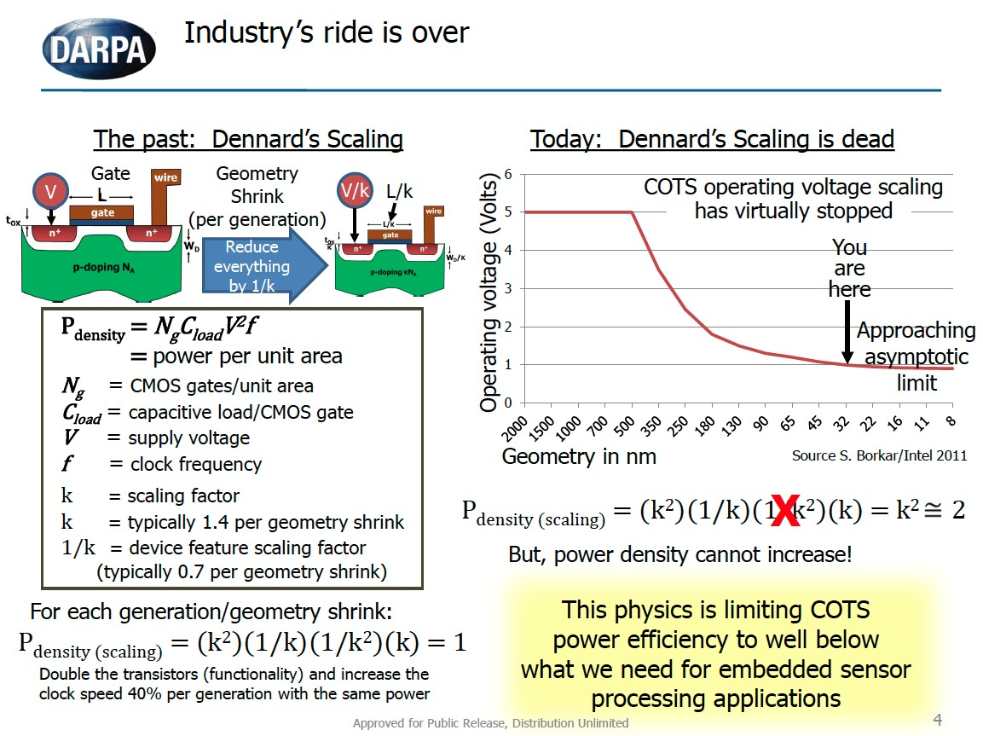

Slide 41
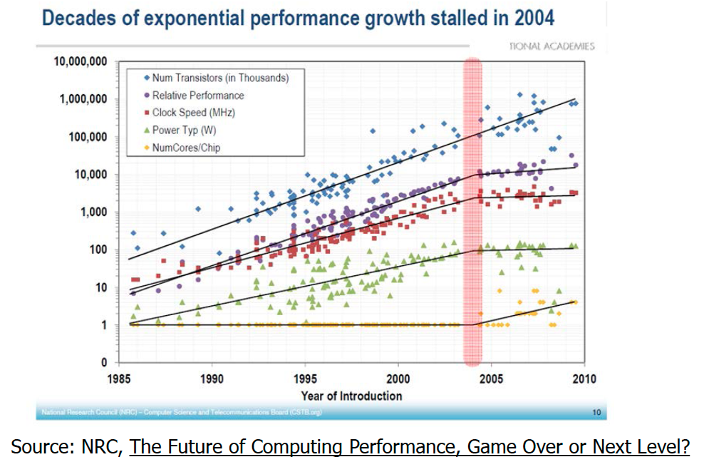

Slide 42
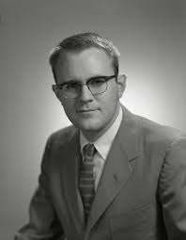
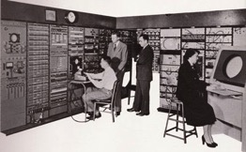
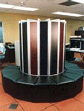
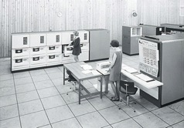
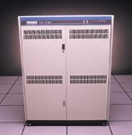
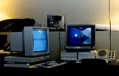
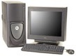
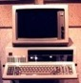
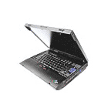
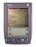
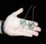
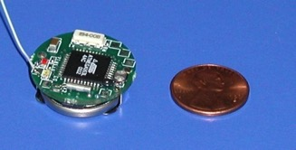
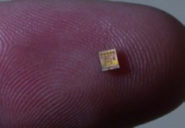
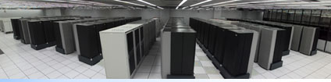
Not so fast! Bell’s Law of Computer Classes: A new computing class roughly every decade
Number Crunching
Data Storage
Mainframe
log (people per computer)
Minicomputer
productivity
interactive
Workstation
PC
Streaming information
to/from physical world
Laptop
CPSD
year
“Roughly every decade a new, lower priced computer class forms based on a new programming platform, network, and interface resulting in new usage and the establishment of a new industry.”
Credit: D. Culler
Notes:
So if we look at the computing spectrum today, each of the classes exist simultaneously. In a room we can put 100s of teraflops and many petabytes of computing.
Our productivity, document preparation, and personal information management fits in our pocket and a new class is emerging that will provide a means of streaming information to and from the physical world like we have never seen before.

Slide 43
Technology Trends
Multi-core embedded with System-on-a-Chip (SoC)
Better, cheaper, lower power sensors
Better communication
Bluetooth Low-Energy
802.15.4
802.11 AC
LP-WAN
Energy Harvesting / Ultra Low Power

Slide 44
Why is embedded different?

Slide 45
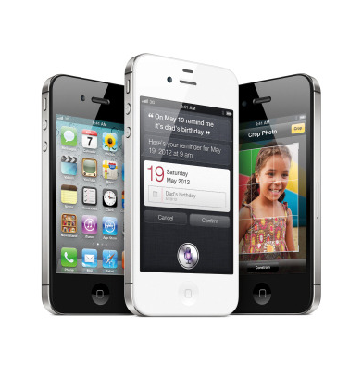
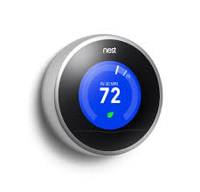

Typical Embedded System Challenges (1-2)
Small Size, Low Weight
Hand­held electronics
Transportation applications ­­ weight costs money
Low Power
Battery power for 8+ hours (laptops often last only 2 hours)
Limited cooling may limit power even if AC power available

Slide 46

Typical Embedded System Challenges (2-2)
Harsh environment
Heat, vibration, shock
Power fluctuations, RF interference, lightning
Water, corrosion, physical abuse
Safety-critical operation
Must function correctly
Must not function incorrectly
Extreme cost sensitivity
$.05 adds up over 1,000,000 units

Slide 47
CPU: An All­ Too ­Common View of Computing
Measured by: Performance
CPU

Slide 48
An Enlightened Computer Engineer's View
Measured by: Performance, Cost
Compilers & OS matter
Cache
Memory
CPU
I/O

Slide 49
An Embedded Computer Designer's View
Measured by: Cost, I/O connections, Memory Size, Performance
Memory
Cache
Microcontroller
A/D
CPU
D/A
MMI
I/O

Slide 50
Modern Embedded Systems View
Measured by: Does it actually work? (and all of the other stuff)
Memory
Network
Cache
Microcontroller
Sensors
A/D
CPU
D/A
Actuator
Distributed!
Diagnostic
tools
MMI
I/O
Auxiliary Systems
(power, cooling)
Electro-mechanical
backup and safety
External
Environment
Memory
Memory
Network
Cache
Microcontroller
Network
Cache
CPU
Microcontroller
Sensors
A/D
D/A
Actuator
Sensors
A/D
CPU
D/A
Actuator
Diagnostic
tools
MMI
I/O
Auxiliary Systems
(power, cooling)
Diagnostic
tools
Auxiliary Systems
(power, cooling)
MMI
I/O
Electro-mechanical
backup and safety
Electro-mechanical
backup and safety
External
Environment
External
Environment

Slide 51




















Embedded Systems Careers

Slide 52

Digital Camera : An example of embedded system

Slide 53
Example 1: The Domestic Fridge
An Embedded
System
Compressor Control
Alarm
Display
20
Human
The
Embedded
Interaction
Computer
Networked
Actual Temperature
Interaction
(Maybe!)
Required Temperature

Slide 54
Example 2: Car Door Control, within a Larger Network

Slide 55
Architecture of embedded systems

Slide 56
The Embedded System – Generic Block Diagram
An embedded system is a system whose principal function is not computational, but which is controlled by a computer embedded within it.

Slide 57
Some Computer Essentials
A computer can be simplified down to the essential elements shown.
Data
Memory
The
Central
Outside
Input/
Processing
World
Output
Unit (CPU)
Program
Memory

Slide 58

Von Neuman and Havard Architecture

Slide 59
What can the Computer Actually Do? - Instructions and Instruction Sets
A computer “executes” instructions in its Arithmetic Logic Unit (ALU), running through a series of instructions called a program. An ALU can only do a few things, but it can do them very fast. A typical 8-bit ALU can do the list shown below. A is the “Accumulator”, a digital register where the computations actually occur, and M is a location in memory. The ALU in turn forms part of the Central Processing Unit (CPU).

Slide 60
How Instruction Sets are Made: the “CISC” Machine
Any CPU has a set of instructions that it recognizes and responds to; all programs are built up in one way or another from this instruction set. We want computers to execute code as fast as possible, but how to achieve this aim is not always an obvious matter.
One approach is to build sophisticated CPUs with exotic instruction sets, with an instruction ready for every foreseeable operation. This leads to the CISC, the Complex Instruction Set Computer. A CISC has many instructions, and considerable sophistication. Yet the complexity of the design needed to achieve this tends to lead to slow operation. One characteristic of the CISC approach is that instructions have different levels of complexity. Simple ones can be expressed in a short instruction code, say one byte of data, and execute quickly. Complex ones may need several bytes of code to define them and take a long time to execute.
A CISC machine is generally recognised by:
Many instructions (say over one hundred), some with considerable sophistication;
Instruction words are of different length;
Instructions take different lengths of time to execute.

Slide 61
How Instruction Sets are Made: the “RISC” Machine
Another approach is to keep the CPU very simple, and have a limited instruction set. This leads to the RISC approach – the Reduced Instruction Set Computer. The instruction set, and hence overall design, is kept simple. This leads to fast operation. One characteristic of the RISC approach is that each instruction is contained within a single binary word. That word must hold all information necessary, including the instruction code itself, as well as any address or data information also needed. A further characteristic, an outcome of the simplicity of the approach, is that every instruction normally takes the same amount of time to execute.
A RISC machine is generally recognised by:
Few instructions (say well below one hundred),
Each performs a very simple action;
All instructions are single word;
All, or almost all instructions take the same length of time to execute.

Slide 62


The Microcontroller
A microcontroller is an integrated chip that is often part of an embedded system.
Microcontroller includes a CPU, RAM, ROM, I/O ports, and timers like a standard computer
They are much smaller and simplified so that they can include all the functions required on a single chip.
Source: http://students.iitk.ac.in/eclub/assets/lectures/embedded/Embedded-Old-1.pdf

Slide 63
The Microcontroller
A microcontroller is a microprocessor designed primarily to perform simple control functions.
Microcontrollers usually have these features
low cost,
physically small,
input/output intensive, and capable of easy interfacing,
limited memory capability for program and data,
instruction set leading to compact code, with limited arithmetic capability,
ability to operate in a real-time environment.
In certain applications the following further features are essential:
ability to operate in hostile environment, e.g. high or low temperature, tolerant to electromagnetic interference,
low power, with features adapted to battery power.

Slide 64
Features of a General-Purpose Controller
A microcontroller = microprocessor core + memory + peripherals

Slide 65


A Gathering of Microprocessors and Microcontrollers
Motorola
68HC05B16
PIC 16F877
PIC 16C72
PIC 16F84A
Motorola 68000
PIC 12F508

Slide 66
PIC Microcontroller
The “PIC” was originally a design of the company General Instruments. It was intended for simple control applications, hence the name – Peripheral Interface Controller. In the late 1970s General Instruments produced the PIC1650 and PIC 1655 processors. Although the design was comparatively crude and unorthodox, the PIC was completely stand-alone, and contained some important and forward-looking features. The simple CPU was a RISC structure, with a single accumulator (called the “Working Register”, and just 30 instructions. The output pins could source or sink much more current than most other microprocessors of the time. Already the trademarks of the PIC were emerging – simplicity, stand-alone, high speed, and low cost.
General Instruments sold off its semiconductor division to a group of venture capitalists, who must have realised the immense potential of these odd little devices. Throughout the nineties the range of available PIC microcontrollers grew, and as they did so they gradually overtook many of their better-established competitors. In many cases PIC microcontrollers could run faster, needed a simpler chip-set, and were quicker to prototype with, than their competitors. Unlike many competitors, Microchip made their development tools simple, and low-cost or free. Moreover, Microchip stayed firmly entrenched in the 8-bit world.
Despite the huge advances that have been made, we can still see features of the old General Instruments PIC, even in the most recent designs.

Slide 67
The PIC Microchip Families
Family | Example Devices | Instruction word size | Stack size (words) | Number of instructions | Interrupt vectors
Baseline | 10F200, 12F508, 16F57 | 12-bit | 2 | 33 | None
Mid-range | 12F609, 16F84A, 16F631, 16F873A | 14-bit | 8 | 35 | 1
High Performance | 18F242, 18F2420 | 16-bit | 32 | 75, including hardware multiply | 2 (prioritised)

Slide 68


PIC 12F508/509

Slide 69
Take home slide
An embedded system is a product that has one or more computers embedded within it, which exercise primarily a control function.
The embedded computer is usually a microcontroller: a microprocessor adapted for embedded control applications.
Microcontrollers are designed according to accepted electronic and computer principles, and are fundamentally made up of microprocessor core, memory and peripherals; it is important to be able to recognize their principal features.
Microchip offers a wide range of microcontrollers, divided into several different families. Each family has identical (or very similar) central architecture and instruction set. However, common features also appear across all their microcontrollers, and knowledge of one family can lead with ease to knowledge of another.
End of Lecture One

